Slide 1
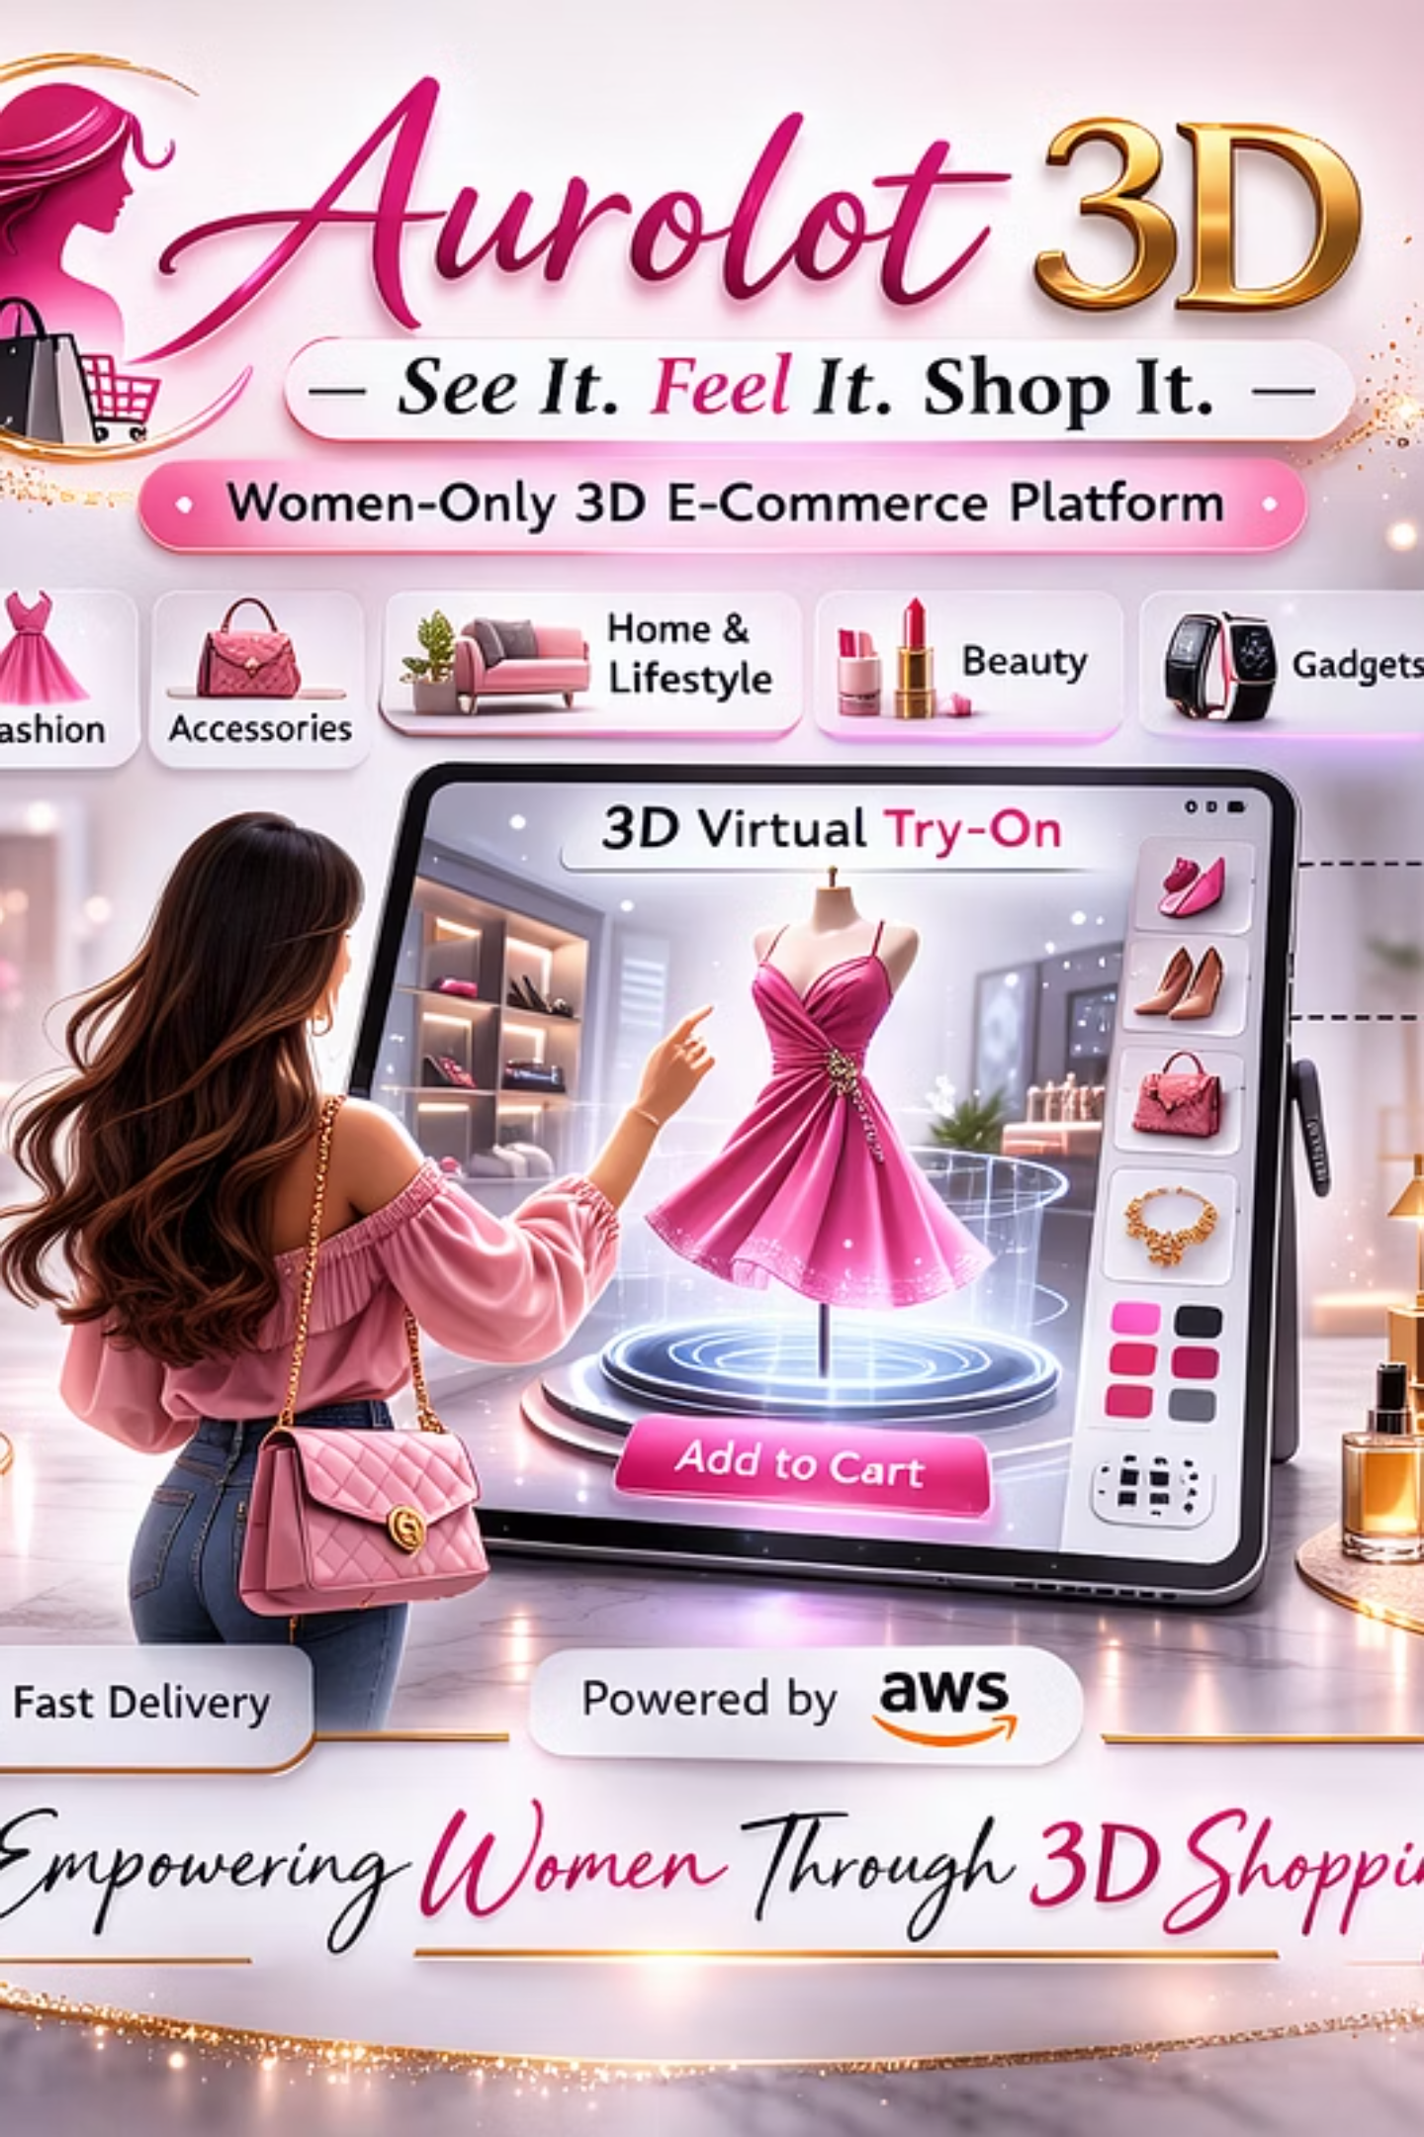
Welcome to Aurolot 3D!
"See It. Feel It. Shop It."

Slide 2




INTRODUCTION
Welcome to Aurolot 3D!
Aurolot 3D is a women-only, cloud-native 3D e-commerce platform built on Amazon Web Services (AWS), created by women, for women. The platform is entirely owned, managed, and operated by women, with women leading every aspect of the business—from technology and operations to customer experience and service delivery.
Immersive Shopping Experience
Curated for Women
Built on AWS
Advanced 3D product visualization allows customers to see, feel, and confidently shop products in a way that reflects how women naturally evaluate quality, fit, comfort, and style.
Specializing in women's fashion, lifestyle furniture, personal gadgets, and curated lifestyle items, all presented with clarity, empathy, and detail that resonate with women's real needs.
Every feature is designed to prioritize trust, safety, personalization, and emotional connection—while delivering a secure, scalable, and high-performance shopping environment.

Slide 3
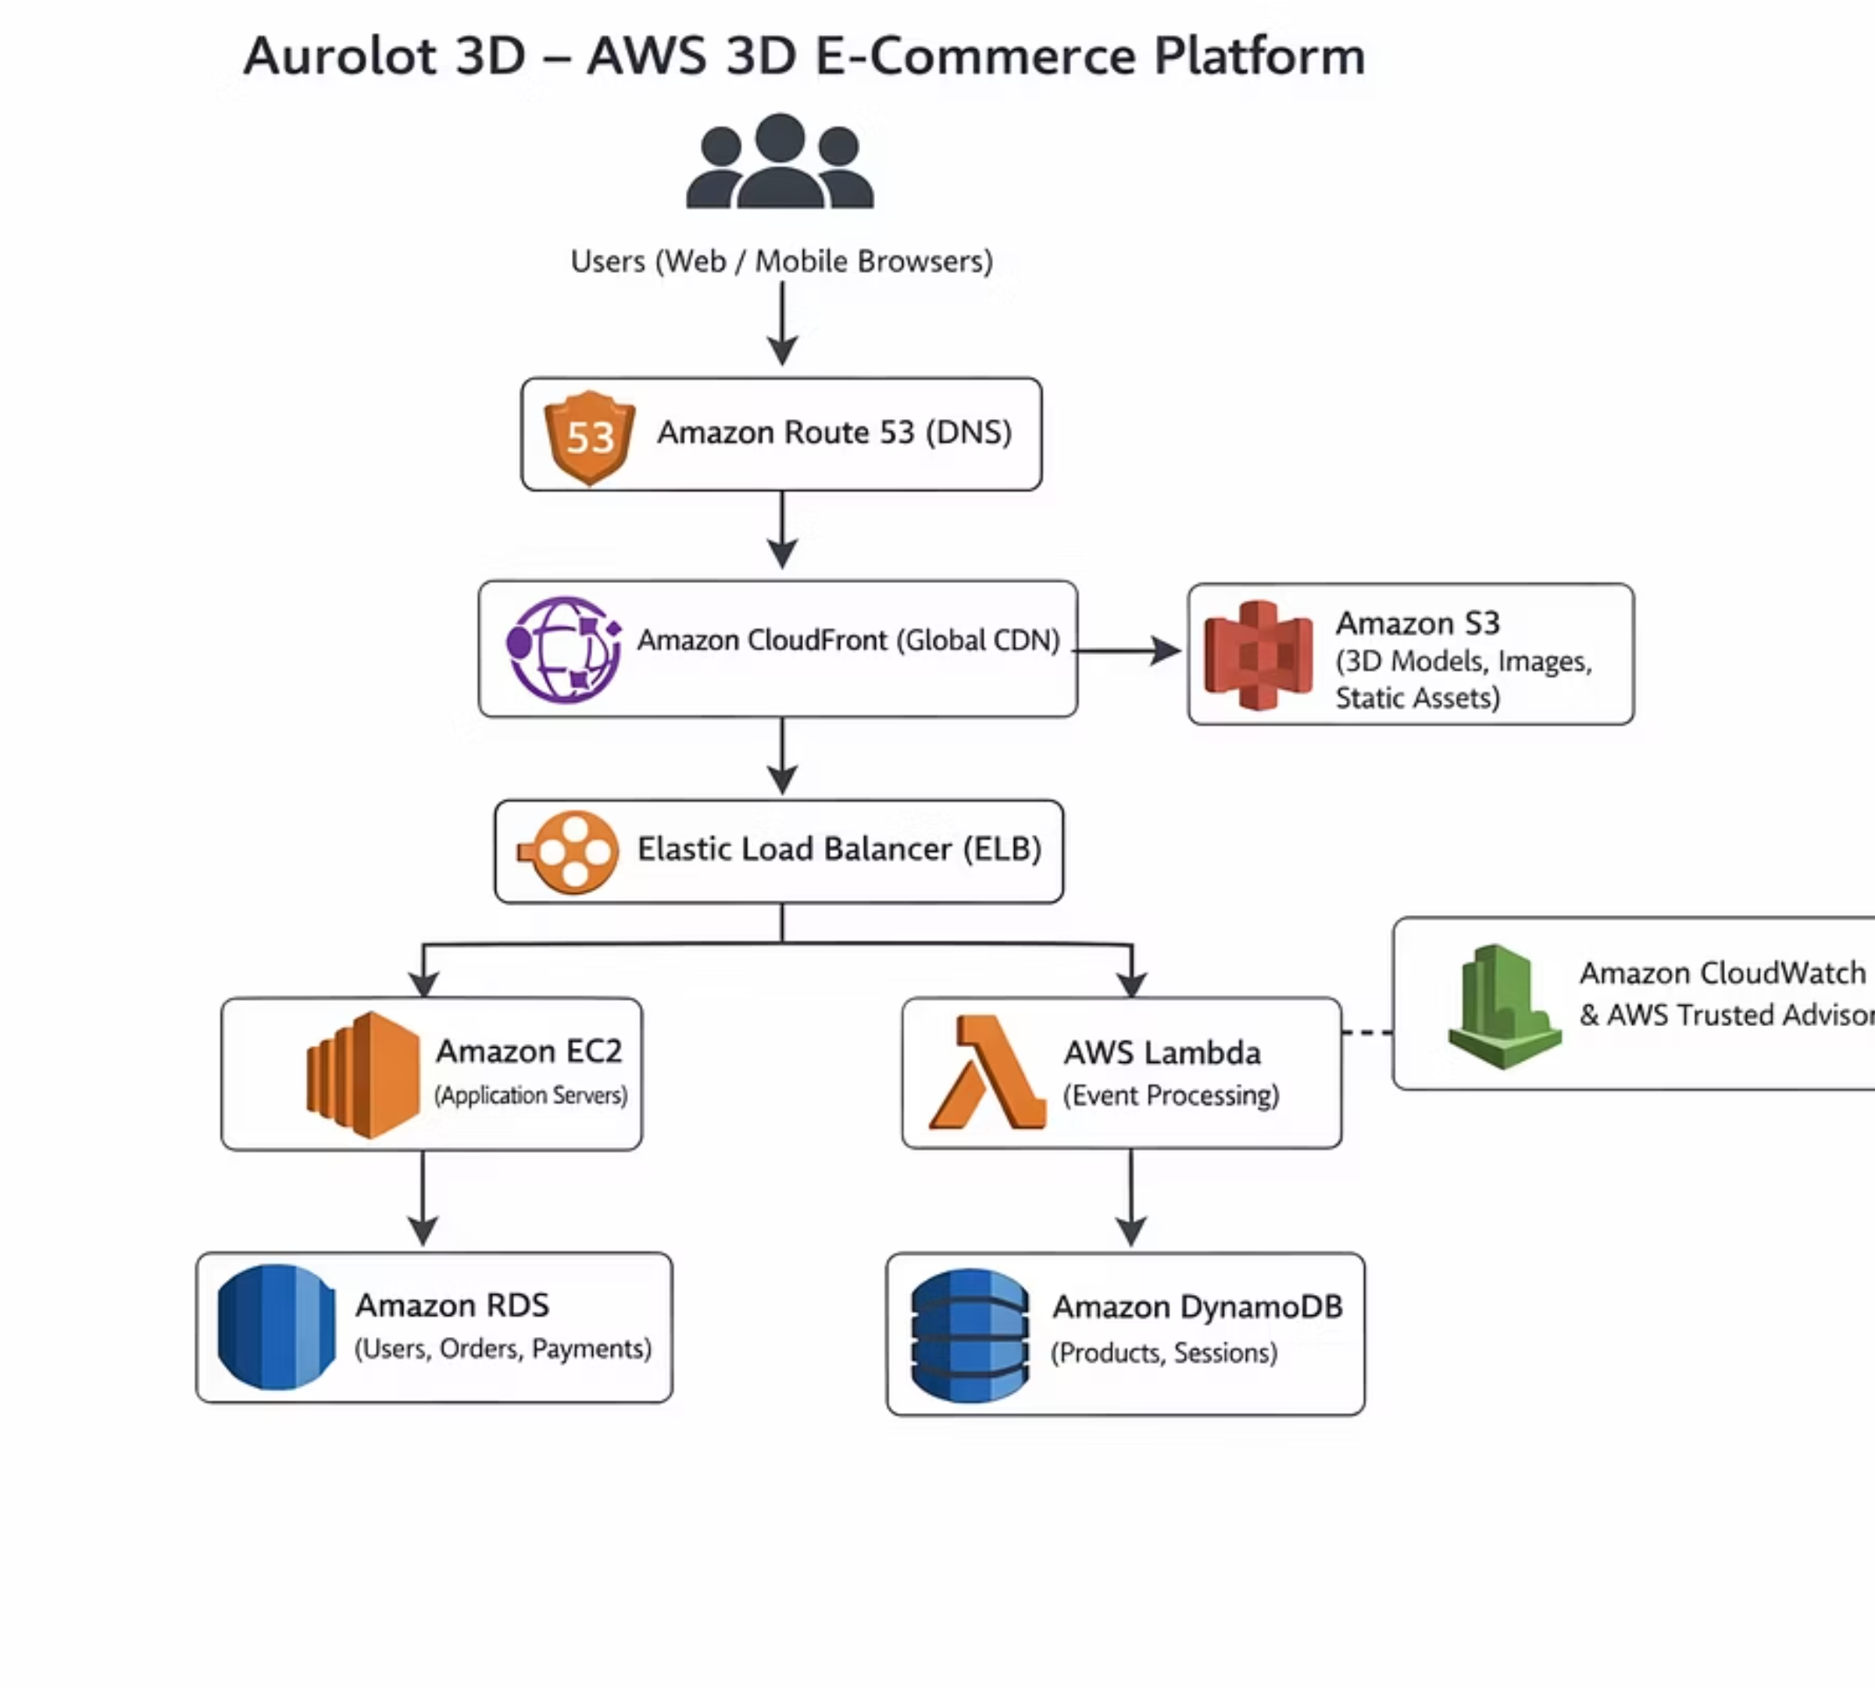

Slide 4
Architecture Overview
The system uses a multi-tier AWS architecture with global content delivery, scalable backend services, and secure data storage using managed AWS services.
How the Aurolot 3D Architecture Works
01
02
03
User Access
Domain Resolution with Route 53
Content Delivery via CloudFront
A woman customer accesses the Aurolot 3D website through a web browser or mobile device, entering the platform's domain name.
Amazon Route 53 translates the domain name into the correct AWS resource address, routing the request to the most reliable and nearest endpoint.
Amazon CloudFront delivers static and 3D content cached at global edge locations, ensuring fast load times and smooth 3D interactions.

Slide 5
ARCHITECTURE FLOW
Aurolot 3D Architecture Continued
Step 4: Static Asset Retrieval
Step 5: Dynamic Requests
Step 7: Event Automation
Step 8: Data Storage
Amazon RDS stores structured data (profiles, orders, payments) while DynamoDB handles high-speed data (sessions, recommendations).
If CloudFront doesn't have cached content, it retrieves assets from Amazon S3, which stores all 3D models and website resources.
Elastic Load Balancer distributes traffic evenly across backend compute resources for actions like login, cart, and checkout.
AWS Lambda executes tasks like order confirmations, email notifications, and inventory updates automatically without dedicated servers.
Step 6: Application Processing
Step 9: Monitoring
Amazon EC2 instances process business logic including women-only access verification, user sessions, and product interactions.
CloudWatch monitors performance and logs activity. Trusted Advisor provides recommendations for cost, security, and reliability.

Slide 6






AWS SERVICES
AWS Services and Business Justification
Amazon Route 53
Amazon CloudFront
Amazon S3
Elastic Load Balancer
Ensures women customers can reliably access the platform using a simple domain name, directing requests to the most appropriate AWS resources for continuous availability.
Ensures 3D models, images, and videos load quickly for women shoppers worldwide by caching content closer to users, eliminating delays in the immersive shopping experience.
Stores all static assets including 3D product models, fashion visuals, and furniture previews with high durability, ensuring valuable product assets remain safe and accessible.
Distributes incoming requests evenly during promotions and product launches, preventing system overload and ensuring consistent performance during peak shopping periods.
Amazon EC2
AWS Lambda
Hosts core application logic including user authentication, women-only access enforcement, shopping cart functionality, and product interactions with automatic scaling.
Automates event-driven tasks such as order confirmations, notifications, inventory updates, and transaction processing without manual intervention or dedicated servers.

Slide 7
DATA & OPTIMIZATION
AWS Services Continued
Key Benefits
Amazon RDS
Manages customer and transaction data including women customer profiles, order history, delivery information, and payments. Ensures secure and reliable transaction processing while reducing database management overhead.
Secure transaction processing
Personalized shopping experiences
Real-time performance monitoring
Continuous optimization
Cost-efficient operations
Scalable infrastructure
Amazon DynamoDB
Enables personalization and fast user experience by storing high-speed data such as product recommendations, user preferences, browsing sessions, and wish lists for smooth, responsive interactions.
Amazon CloudWatch
Monitors system performance, detects issues early, and maintains platform reliability through real-time alerts that help prevent service disruptions affecting customer confidence.
AWS Trusted Advisor
Continuously evaluates the Aurolot 3D environment and provides recommendations to improve security, cost efficiency, and performance, supporting sustainable business growth.

Slide 8

Conclusion
Aurolot 3D delivers a secure, scalable, and high-performance women-only 3D e-commerce solution using AWS.
Secure
Scalable
Built with AWS security best practices to protect customer data and transactions
Automatically adapts to growing demand and business expansion
High-Performance
Women-Centered
Delivers fast, immersive 3D shopping experiences globally
Designed by women, for women, prioritizing trust and personalization

